Slide 1

AUGUST 16, 2020
KYOBI ARTS NETWORKING GROUP
Presented by Claudia Alves

Slide 2
TOPICS AND HIGHLIGHTS
OUR DISCUSSION TODAY
A Short Introduction Our Vision
The Importance of Networking Our New Marketing Approach Event Strategies

Slide 3

KYOBI NETWORKING GROUP
A SHORT INTRODUCTION
Presentations are communication tools that can be used as demonstrations, lectures, speeches, reports, and more. It is mostly presented before an audience. It serves a variety of purposes, making presentations powerful tools for convincing and teaching.

Slide 4

WORDS TO INSPIRE YOU
Effective networking isn't a result of luck - it requires hard work and persistence.
Lewis Howes

Slide 5

KYOBI NETWORKING GROUP
A SHORT INTRODUCTION
Presentations are communication tools that can be used as demonstrations, lectures, speeches, reports, and more.
It is mostly presented before an audience.

Slide 6

NETWORKING IN ACTION
Presentations are tools that can be used as lectures, speeches, reports, and more.
It is mostly presented before an audience. It serves a variety of purposes, making presentations powerful tools for convincing and teaching.

Slide 7
01
02
EXPANDING YOUR PROFESSIONAL OPPORTUNITIES
CONNECTING YOU TO LIKE-MINDED INDIVIDUALS
Presentations are tools that can be used as demonstrations.
Presentations are tools that can be used as demonstrations.
Essence of Networking
03
INFORMATION GATHERING FOR YOUR FIELD
04
BROADENING YOUR PERSPECTIVE
Presentations are tools that can be used as demonstrations.
Presentations are tools that can be used as demonstrations.

Slide 8
DID YOU KNOW?
87%
Of freelance artists have found work through our networking events

Slide 9


WORKING SOLO
WORKING AS A TEAM
Presentations are communication tools that can be demonstrations, lectures, speeches, reports, and more.
Presentations are communication tools that can be demonstrations, lectures, speeches, reports, and more.

Slide 10

WHY DO WE NEED A DEDICATED
ART NETWORKING
GROUP?
Because artists need to collaborate too!

Slide 11

Presentations are tools that can be used as lectures, speeches, reports, and more.
It is mostly presented before an audience. It serves a variety of purposes, making presentations powerful tools for convincing and teaching.

Slide 12

AN IN-DEPTH A
PAST, PRESENT, AND FUTURE OF NETWORKING
Event Overview and Strategies

Slide 13
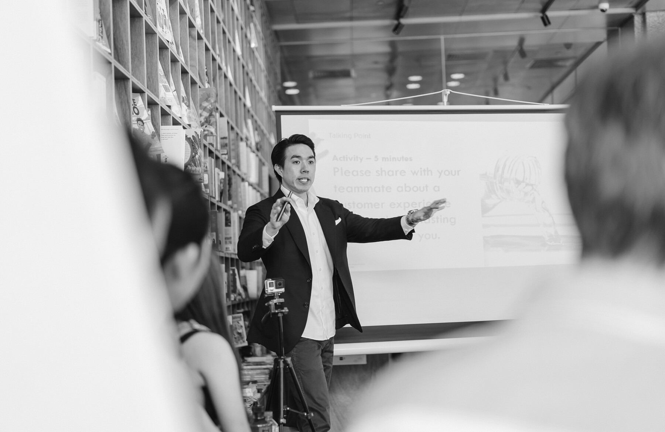
01
OUR PAST EVENTS
July 2020
Presentations are tools that can be used as lectures, demonstrations, speeches, reports, and more.
02
May 2020
Presentations are tools that can be used as lectures, demonstrations, speeches, reports, and more.
03
January 2020
Presentations are tools that can be used as lectures, demonstrations, speeches, reports, and more.

Slide 14

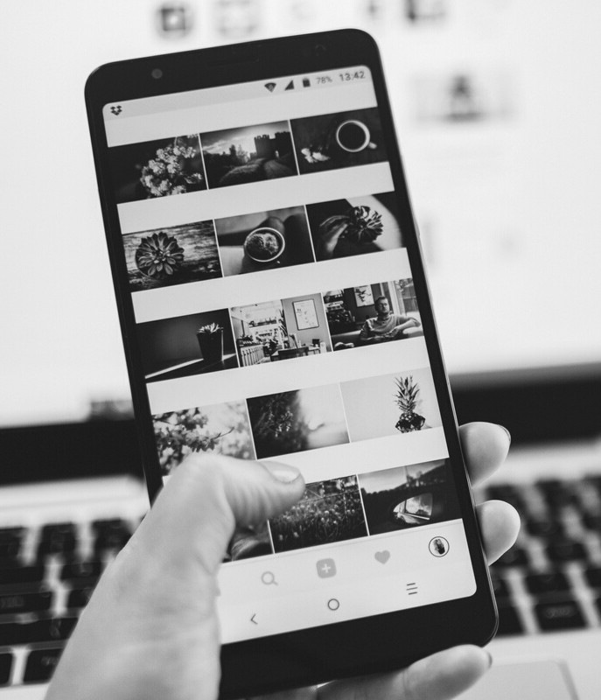
OUR MARKETING APPROACH
FROM PREVIOUS EVENTS
Online and Social Media
Presentations are communication tools that can be demonstrations, lectures, speeches, reports, and more.
Print Media
Presentations are communication tools that can be demonstrations, lectures, speeches, reports, and more.

Slide 15
Social Media Marketing
In Print
Presentations are tools that can be used as lectures, demonstrations, speeches, reports, and more.
Our New Marketing Approach
Presentations are tools that can be used as lectures, demonstrations, speeches, reports, and more.
Physical and In Person
Presentations are tools that can be used as lectures, demonstrations, speeches, reports, and more.
Radio and Television
Presentations are tools that can be used as lectures, demonstrations, speeches, reports, and more.

Slide 16



Setting the date and venue
Planning the Events
Presentations are tools that can be used as lectures, demonstrations.
Identifying a theme
Presentations are tools that can be used as lectures, demonstrations.
Inviting participants and speakers
Presentations are tools that can be used as lectures, demonstrations.

Slide 17
01
New Concepts and Ideas
EVENT STRATEGIES
02
New Presenters and Hosts
FOR FUTURE EVENTS
03
New Marketing Strategies

Slide 18
OUR TARGET MARKET
By Age
Presentations are tools that can be lectures, reports, and more. It is mostly presented before an audience. It serves a variety of purposes, making presentations powerful tools for convincing and teaching.
By Profession
Presentations are communication tools that can be lectures, speeches, reports, and more. It is mostly presented before an audience.
By Lifestyle
Presentations are communication tools that can be lectures, speeches, reports, and more. It is mostly presented before an audience.

Slide 19
$5,000
$10,000
Old event budget
New event budget

Slide 20
OUR PLANNED FUTURE EVENTS
FOR Q3-Q4 OF 2020
August 25
Presentations are tools that can be lectures, speeches, reports, and more.
September 2
Presentations are tools that can be lectures, speeches, reports, and more.
September 19
Presentations are tools that can be lectures, speeches, reports, and more.
Make sure you do enough research to support your points.
Make sure you do enough research to support your points.
Make sure you do enough research to support your points.

Slide 21

Networking
Teaser
Presentations are communication tools that can be demonstrations, lectures, speeches, reports, and more.

Slide 22
PROJECTED ATTENDANCE
40
30
20
BASED ON PREVIOUS EVENTS
10
Presentations are tools that can be lectures, and more. It is mostly presented before an audience. It serves a variety of purposes, making presentations powerful tools for convincing and teaching.
0
Item 1 Item 2 Item 3 Item 4 Item 5

Slide 23



MEET THE TEAM
GET TO KNOW THEM
Liana Collins
Designer
Torie Simmons
Marketer
Rajeev Solomon
Artist

Slide 24
Facebook
Presentations are communication tools that can be demonstrations.
Instagram
Presentations are communication tools that can be demonstrations.
Find Us Online
Twitter
Presentations are communication tools that can be demonstrations.

Slide 25
CONTACT INFORMATION
Email Address
hello@reallygreatsite.com
Mailing Address
123 Anywhere St., Any City, State, Country 12345
GET IN TOUCH
Phone Number
123-456-7890

